Slide 1
Style Transfer of Images & Videos
Yicheng Shen, Zhenyuan Wang
Notes:
Hi everyone. Today, we will present our project, Style Transfer of Images and Videos.
I will first briefly go over general ideas. And then we will see the more exciting stuff, which are the visual results.

Slide 2
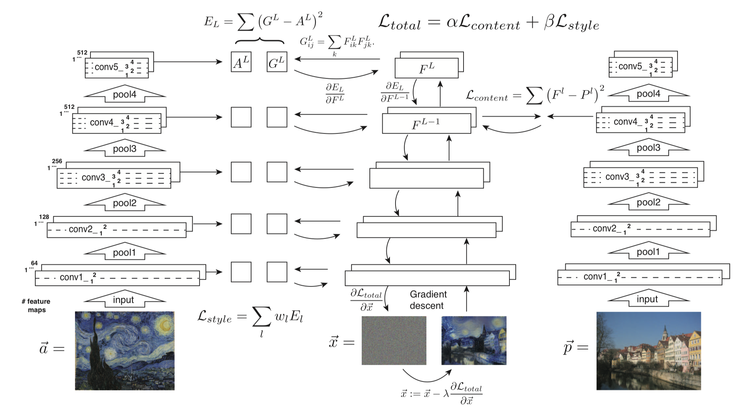
Ideas in Gatys et al. Paper
Figure from Image Style Transfer Using Convolutional Neural Networks
Notes:
In our project, we implemented two versions of style transfer. The first one is based on ideas in Gatys et al. paper and the other one is based on ideas in Johnson et al. paper.
On this slide, it shows the model architecture in Gatys paper. We use a pretrained VGG network as our backbone. It is shown by the stack of convolution and pooling layers. Note that in the original VGG network, there are more fully connected layers following the convolution layers for tackling the classification task. Here we only need the feature maps. So we removed those fully connected layers.
We pass in three things: a style image, a content image, and a white noise image. These inputs go through the backbone. Two losses are being computed here. At layers that we specify, a style loss and a content loss are calculated. The sum of these two losses produce the total loss. We use that to do optimization. Note that we do not optimize parameters in the backbone network. What we optimize is the white noise image such that its style looks more and more similar to the style image, but at the same time still keeping the general content in the content image.

Slide 3
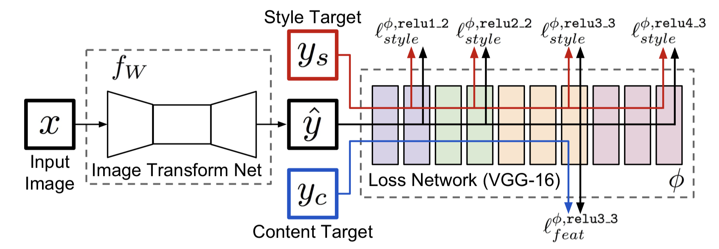
Ideas in Johnson et al. Paper
Figure from Perceptual Losses for Real-Time Style Transfer and Super-Resolution
Notes:
Here is the architecture of our second implementation. It shares some similarities with the previous architecture. Both of them use the pretrained VGG network. Here, it’s called the loss network. Style loss and content loss are computed through the loss network.
Although there are many similarities, what we optimize is very different. Remember that we optimize the white noise image in the previous architecture. Here we optimize the weights of the Image Transformation Network. The Image Transformation Network is a residual network consisted of some convolution layers and residual layers. As its name suggests, it is used to transform an input image into a stylized image. What we optimize in training is the weights of this network. Therefore, for each style, we can train and get a set of weights for the transformation network. With a set of weights learned from an artistic style, we can transform an arbitrary number of images into that particular artistic style.

Slide 4
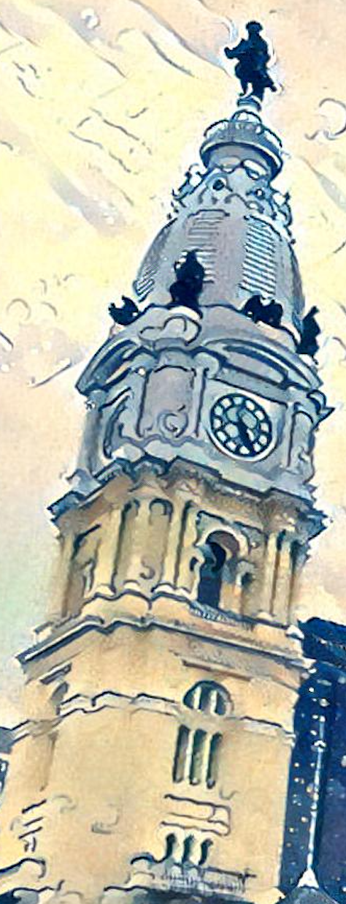
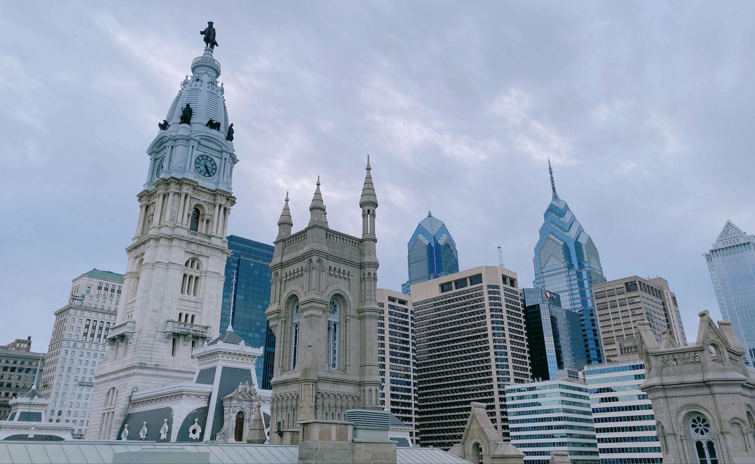
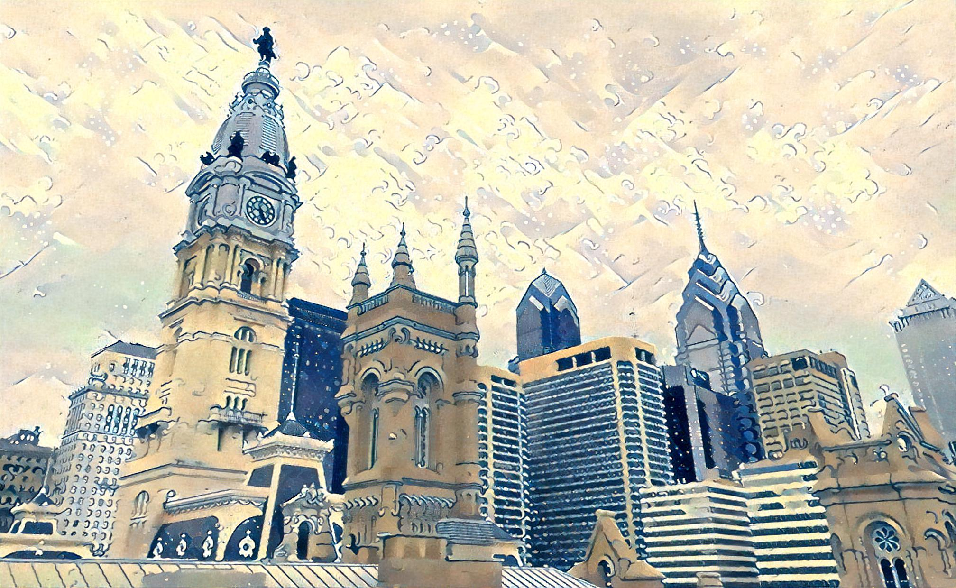
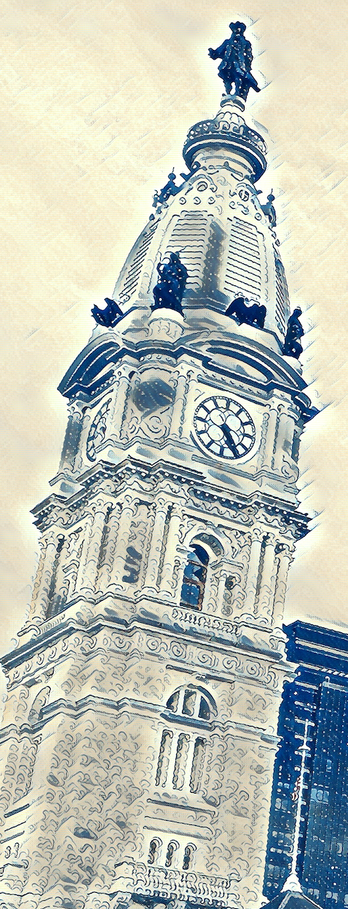
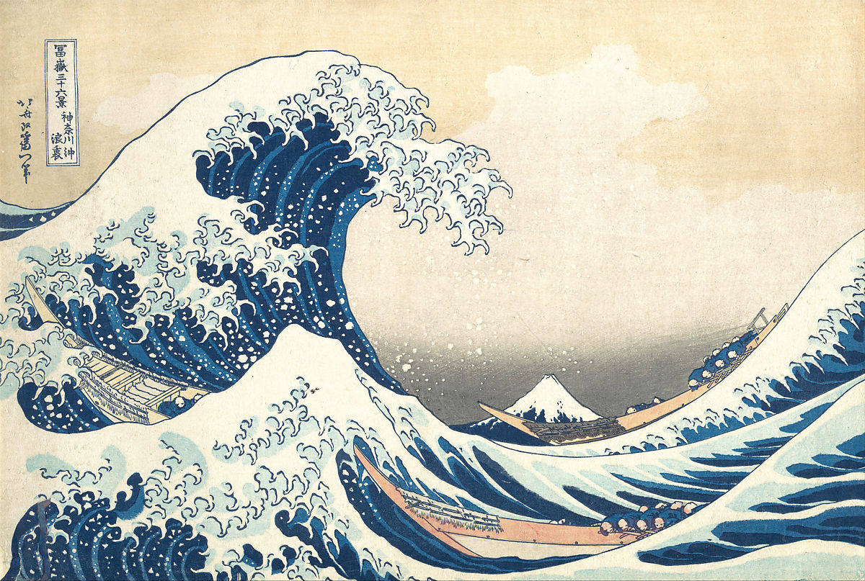
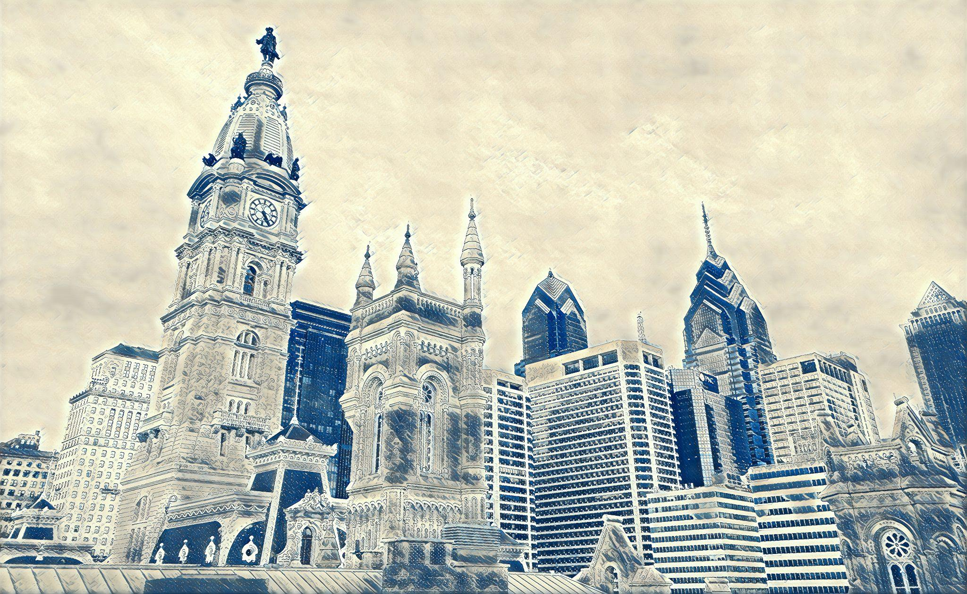
Results from 2 implementations
Gatys
Content Image
Gatys
Johnson
Style Image
Johnson
Notes:
Here we show comparison of results from our two different implementations.
On the left, we have the original content image featuring the good looking architectures in Center City Philadelphia. And we use The Great Wave by Katsushika Hokusai as our style image.
In the middle, we show the stylized images. Both implementations achieve visually pleasing results. But the Johnson paper implementation better captures the style and transforms even the fine details of the content image. To show this comparison, we can zoom into the bell tower sections and take a close look. In the Gatys version, some parts seem to be flattened out. In contrast, in the Johnson version, the texture on the bell tower are transformed into the curly wave looking strokes.
In addition to these visual improvements, we also get a significant speedup with the Johnson version. And we get to scale up to much larger images.

Slide 5
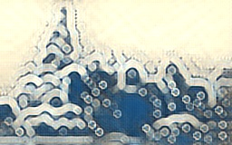
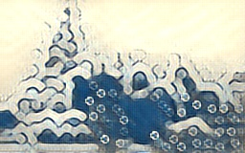
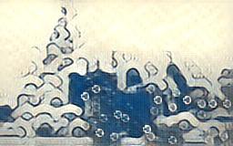
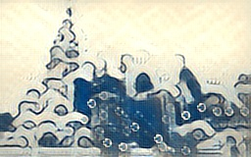
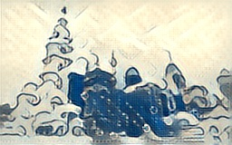
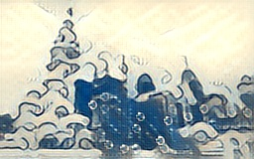
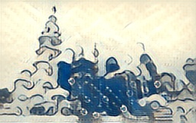
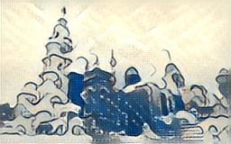
Implementation Pipeline & Results
content_batch: 1000
content_batch: 1500
content_batch: 2000
content_batch: 2500
content_batch: 3000
content_batch: 3500
content_batch: 4000
content_batch: 4500
Notes:
In order to track the training process, we have saved the training results in our Image Transforming Net for every 500 content_batch. Hence we will be able to detect at which point the result is good enough and can use the corresponding trained model for further production. Besides, since the progress is recorded, we don’t always need to go back to the beginning and restart the training if there is so random interruptions during the training.
In average, it took 0.016 s to generate one image (256 * 160) and 1.52s to generate (4032 * 2480) with the pretrained model by using Johnson’s methods we mentioned before.

Slide 6
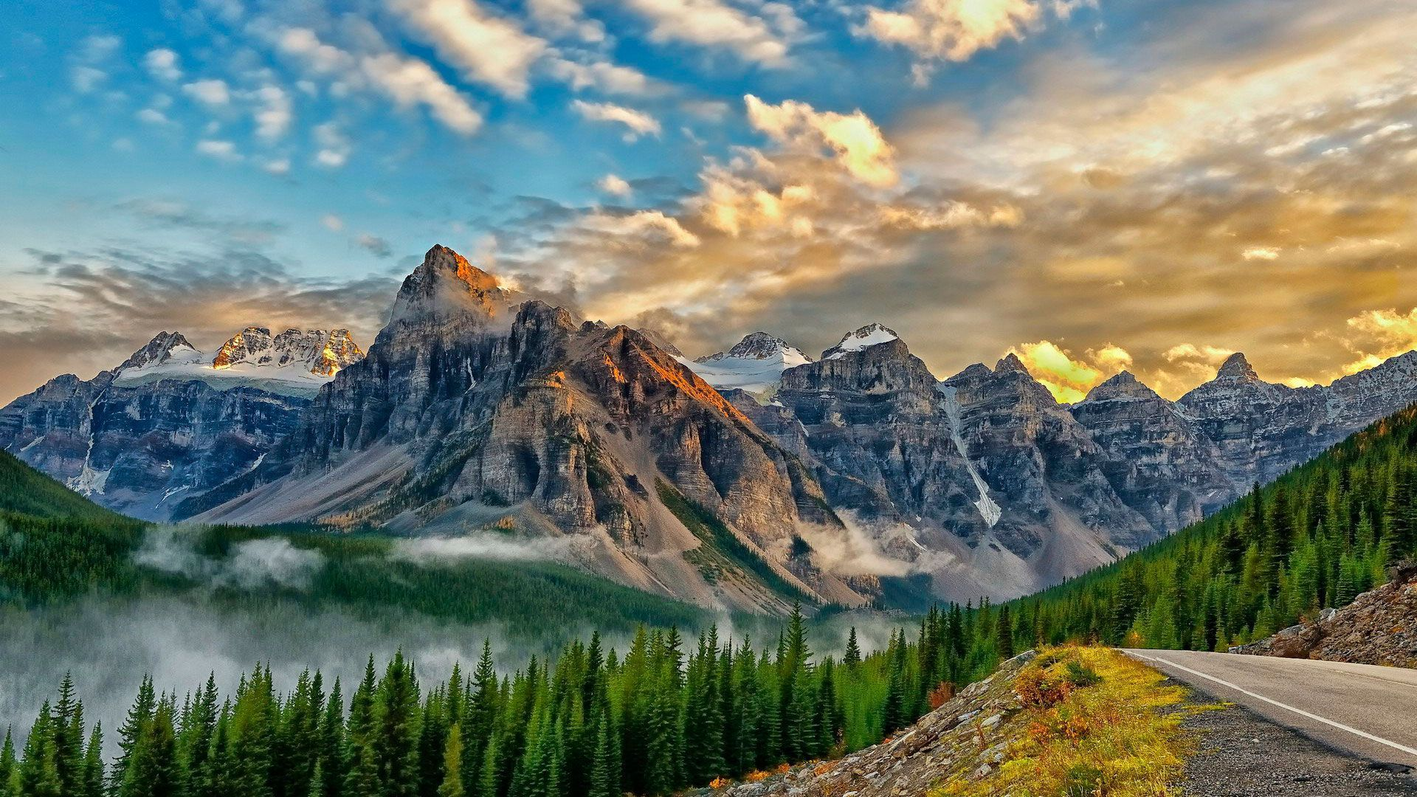
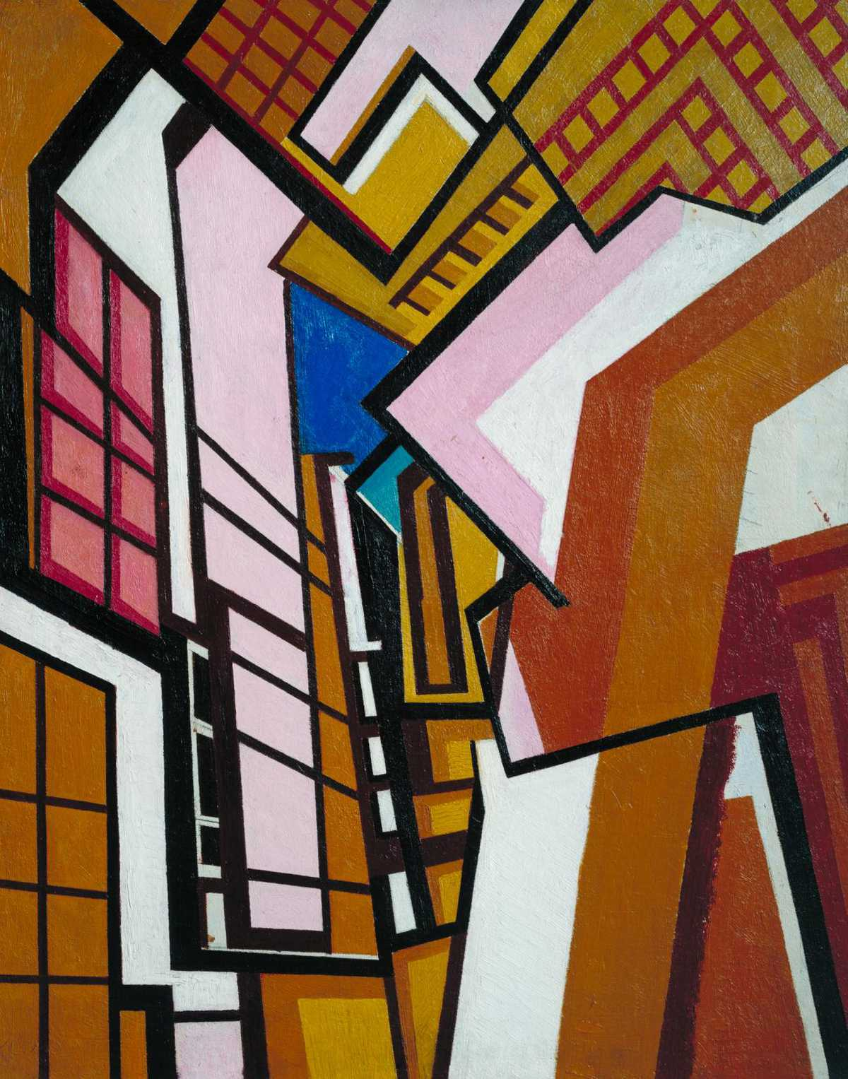
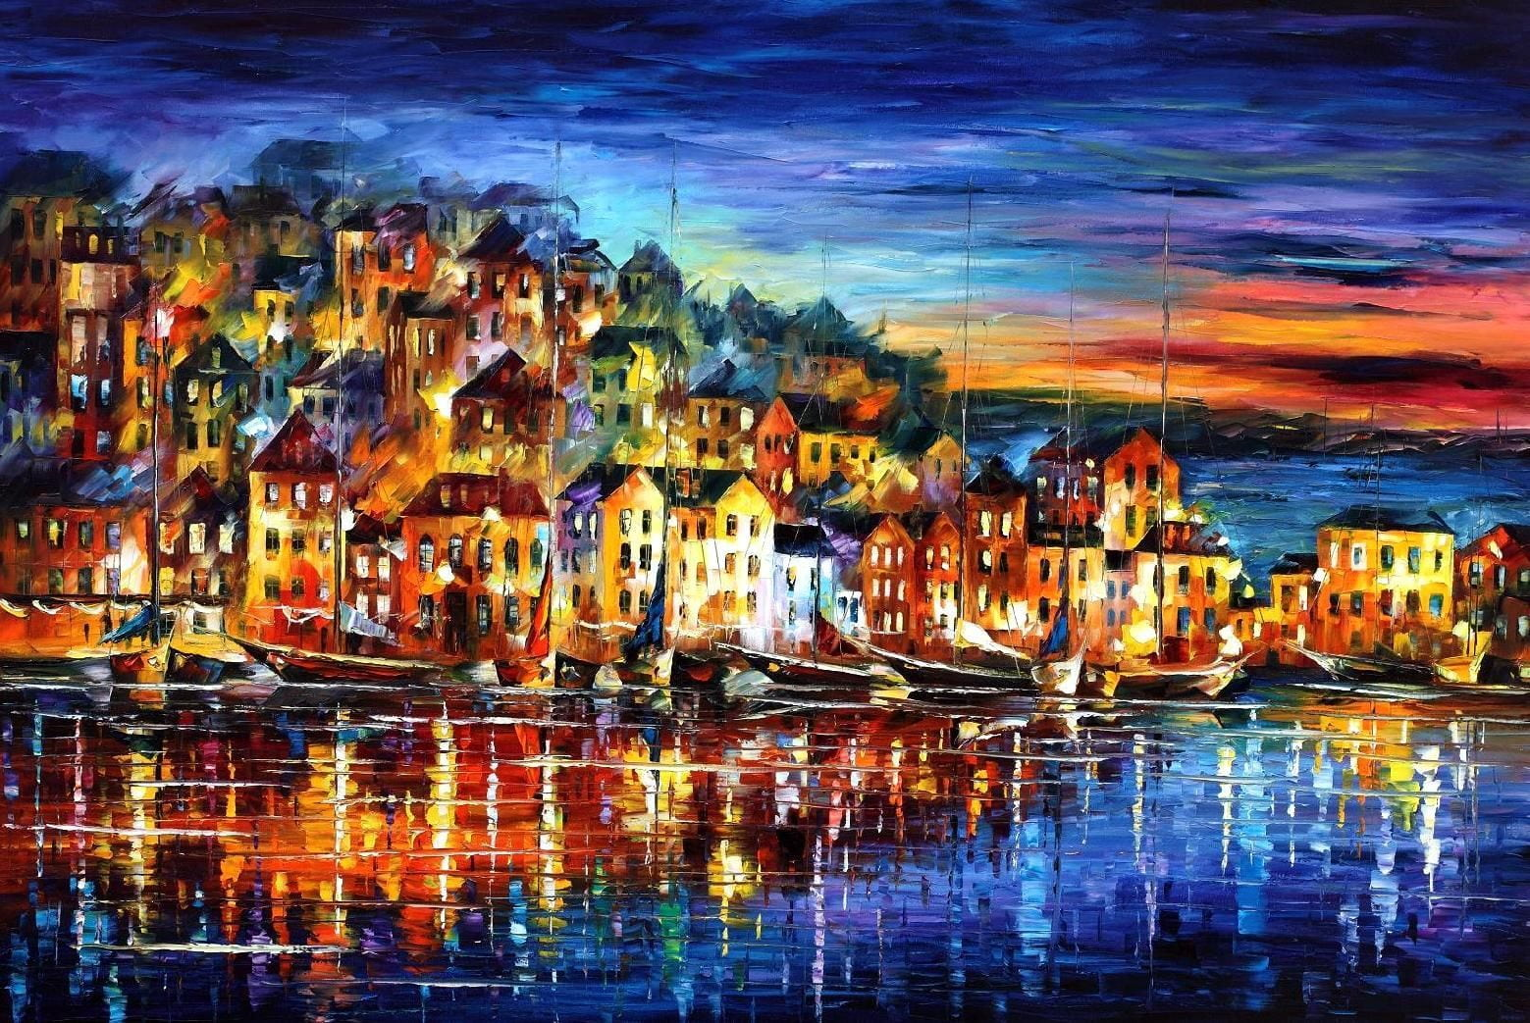
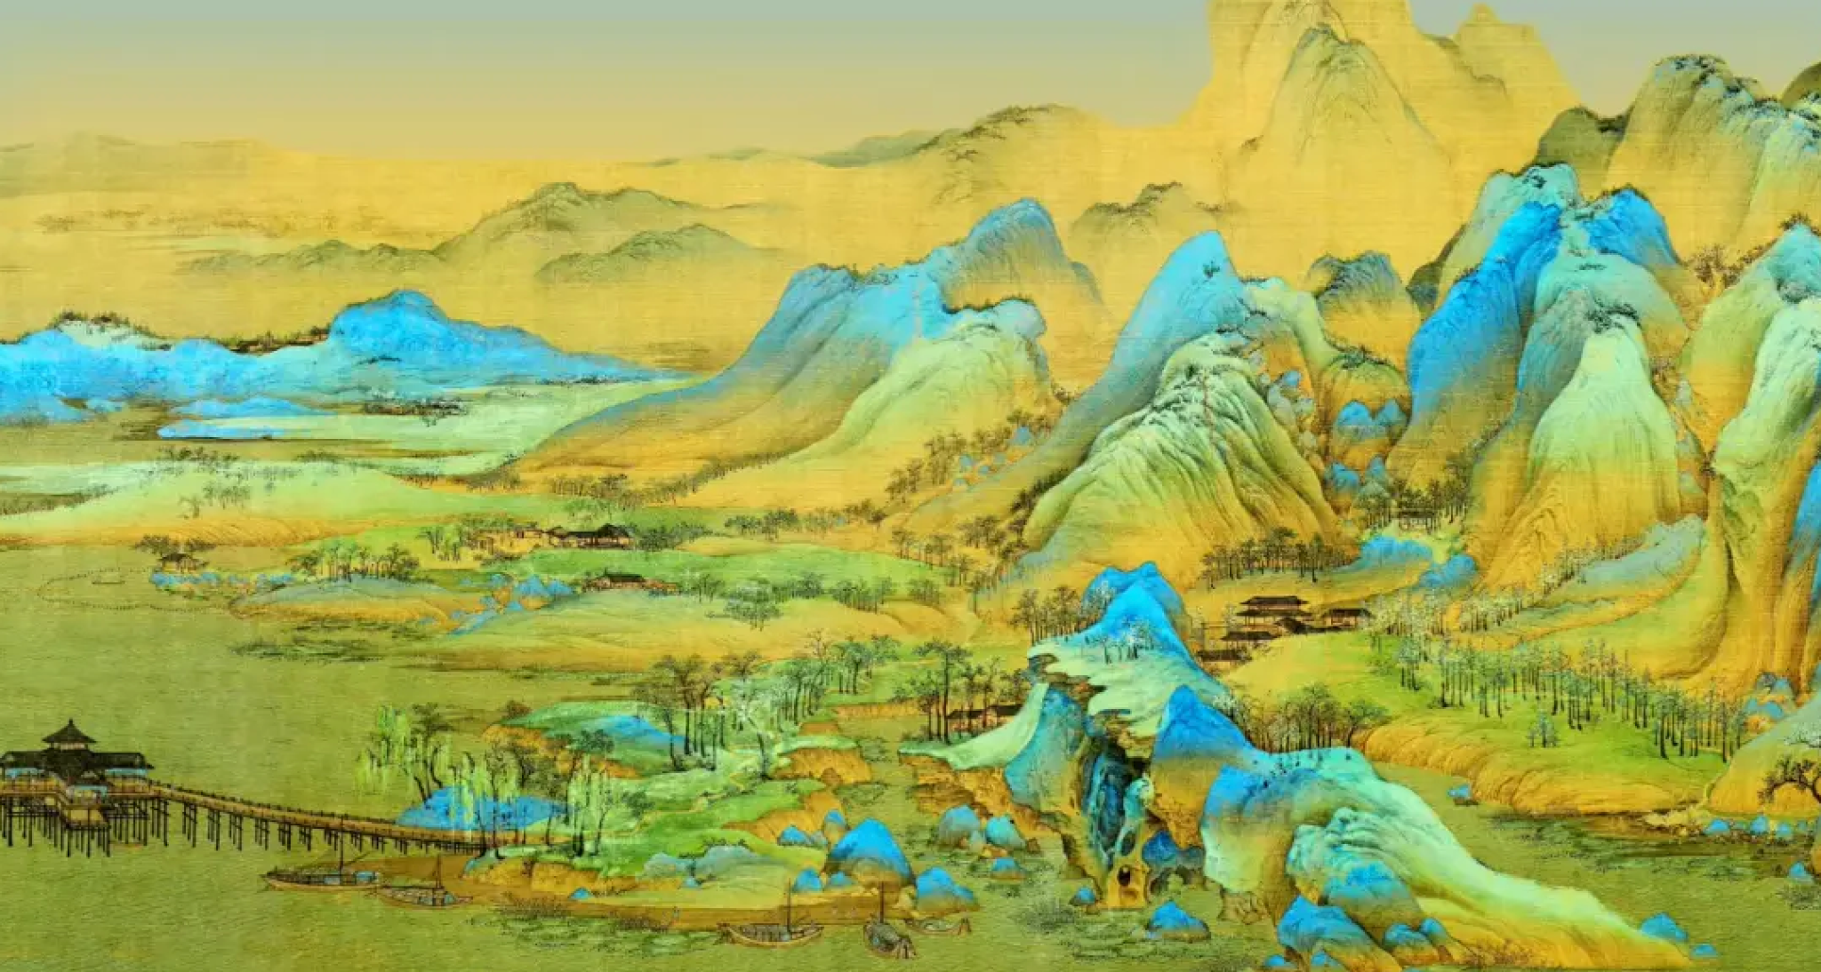
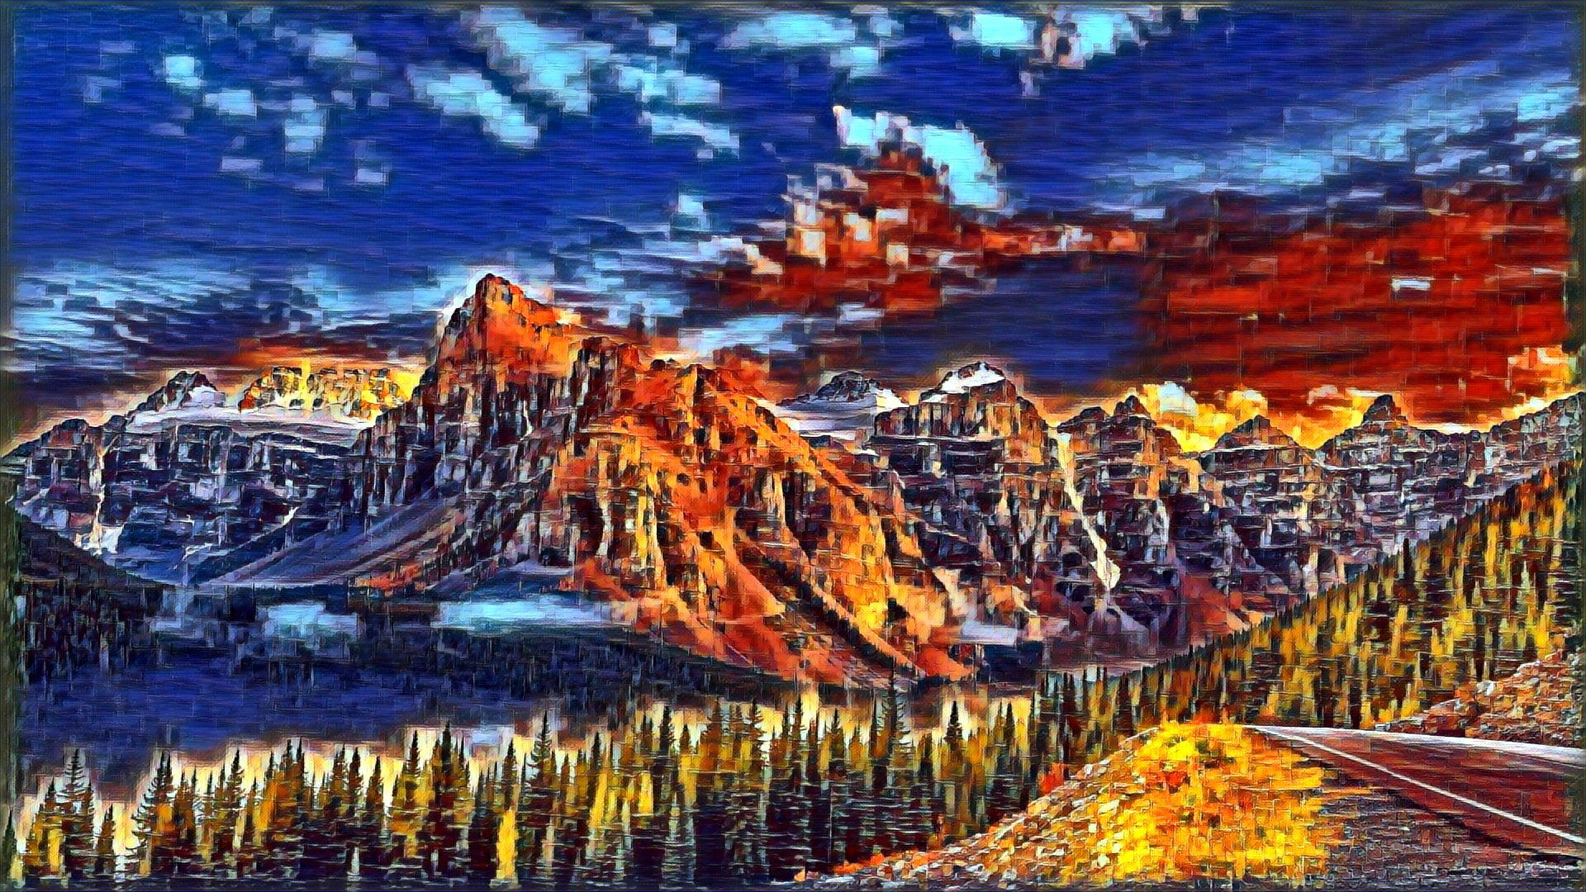
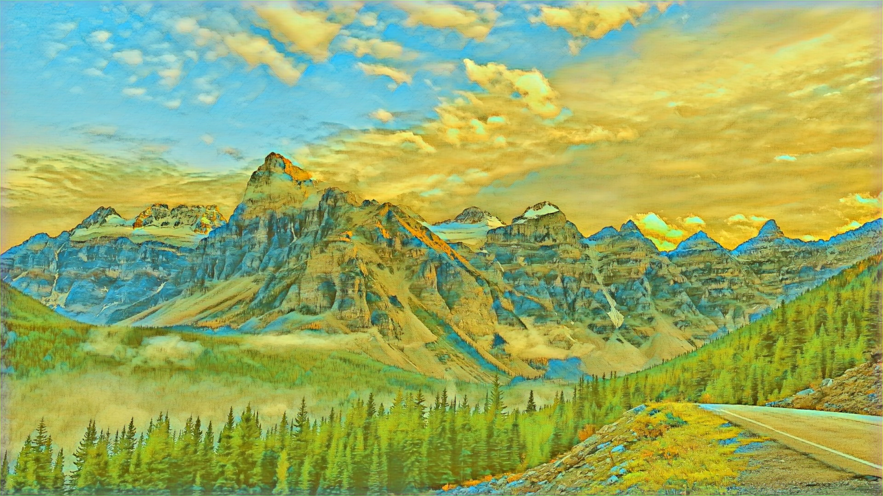
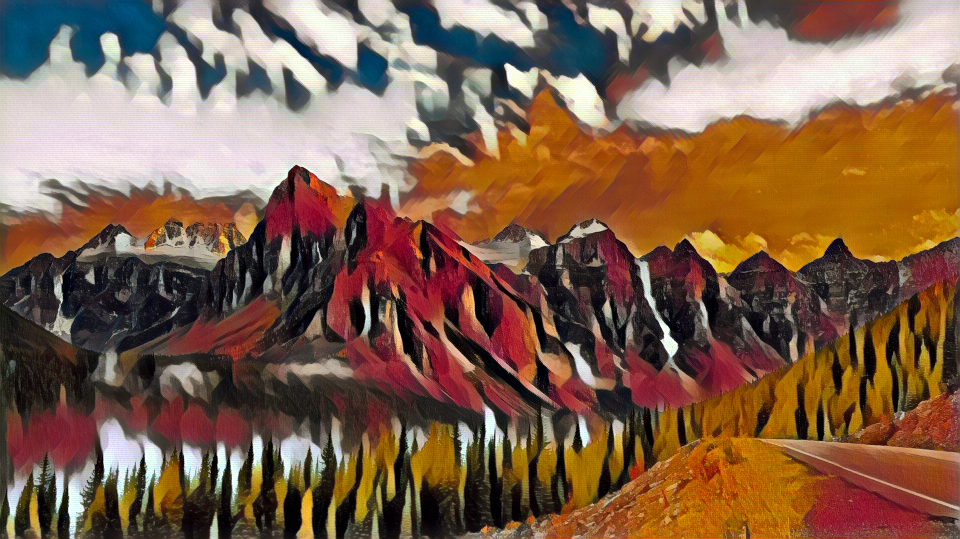
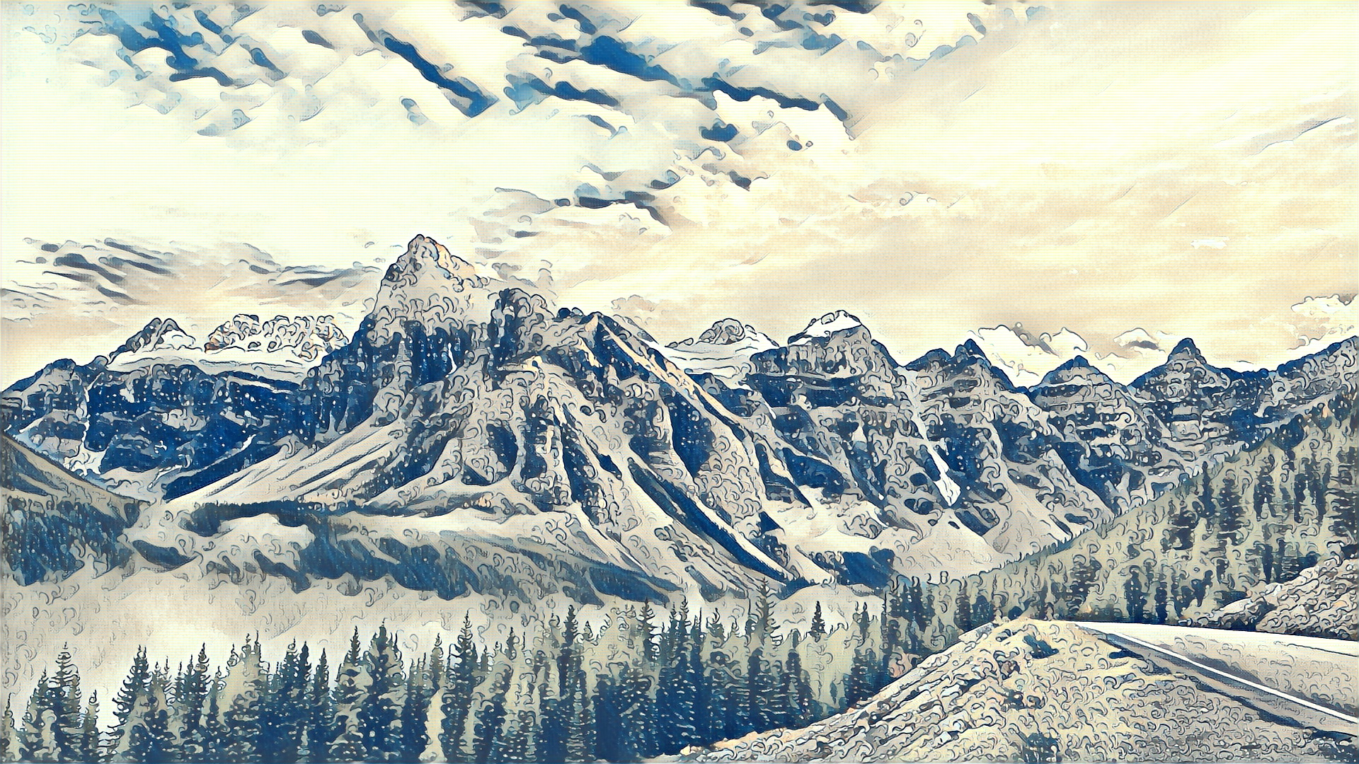
Visual Results
Notes:
Here is an example of a content image and several style images we used for style transfer and let’s see what we get
But before we see the results, let’s try to look into the style images and estimate what will be the result.
Colors and the arrangement of colors
Expressions on mountains
Colors and Geometric shapes
Wave curves and emphasis on details

Slide 7
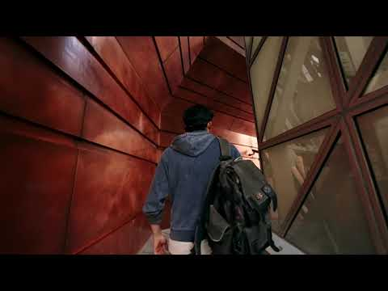
Result Videos
Notes:
Now it comes to video style transfer. Different from transferring a single image, as for the transformation on video, we also need to consider about the continuity between frames while doing the style transfer on these frames. As a result, to solve this problem, an algorithm which can more focus on higher-level features might be suitable for the video style transformation which is exactly what Johnson’s paper is doing.
A little intro to the video itself. This is commercial video for a car brand which want to use some artistic filming techniques to show off the dreamlike and modern concepts. Hence, we thought applying the artistic style transfer on some parts of the video will be a powerful tool to express this idea.
Processing time: 0.15 - 0.23 sec per frame
https://youtu.be/UZIe1LwtETI

